Slide 1
Disruption of Cortical Resting state Network correlation Structure in mild cognitive impairment and Alzheimer’s disease
Kamil A. Grajski, PhD
NuroSci, LLC
February 2, 2017

Slide 2
disclaimerS
Work presented here is a research snapshot
Manuscript(s) in preparation
Peer-review pending

Slide 3
conclusions
Confirm efficacy of Alzheimer’s Disease Neuroimaging Initiative (ADNI) fMRI data for task-free resting-state network (RSN) analysis
Confirm and extend key group-level findings of disruption of intra-RSN, inter-RSN and select inter-network node correlation structure in the progression from Cognitively Normal (CN) to Mild Cognitive Impairment (MCI) and Dementia (D)
Confirm and extend key group-level findings of disruption of correlation structure involving entorhinal cortex (EC), hippocampus (H), parahippocampal gyrus (PHG), and parietal cortex (PC)

Slide 4
Discussion topics
Alzheimer’s Disease Neuroimaging Initiative (ADNI) Overview
Results with Task-Free RSNs
Results with Key Anatomical Locations
Comparison with Previous Findings
Next Steps

Slide 5
ADNI Overview
Ongoing public-private multi-site cohort study
PI: Michael Weiner, MD (UCSF)
Goal: detect and track AD through biomarkers
PET+FDG; PET + Florbetapir F18; MRI; Genetic (APOE); CSF; Cognitive;
50+ sites; > 1000 Participants; open data-sharing model
ADNI 1 (2004); ADNI GO (2009); ADNI 2 (2010); ADNI 3 (2015)
ADNI 2 included a sub-study on task-free resting-state fMRI
The focus of this presentation is on the ADNI 2 rs-fMRI data

Slide 6
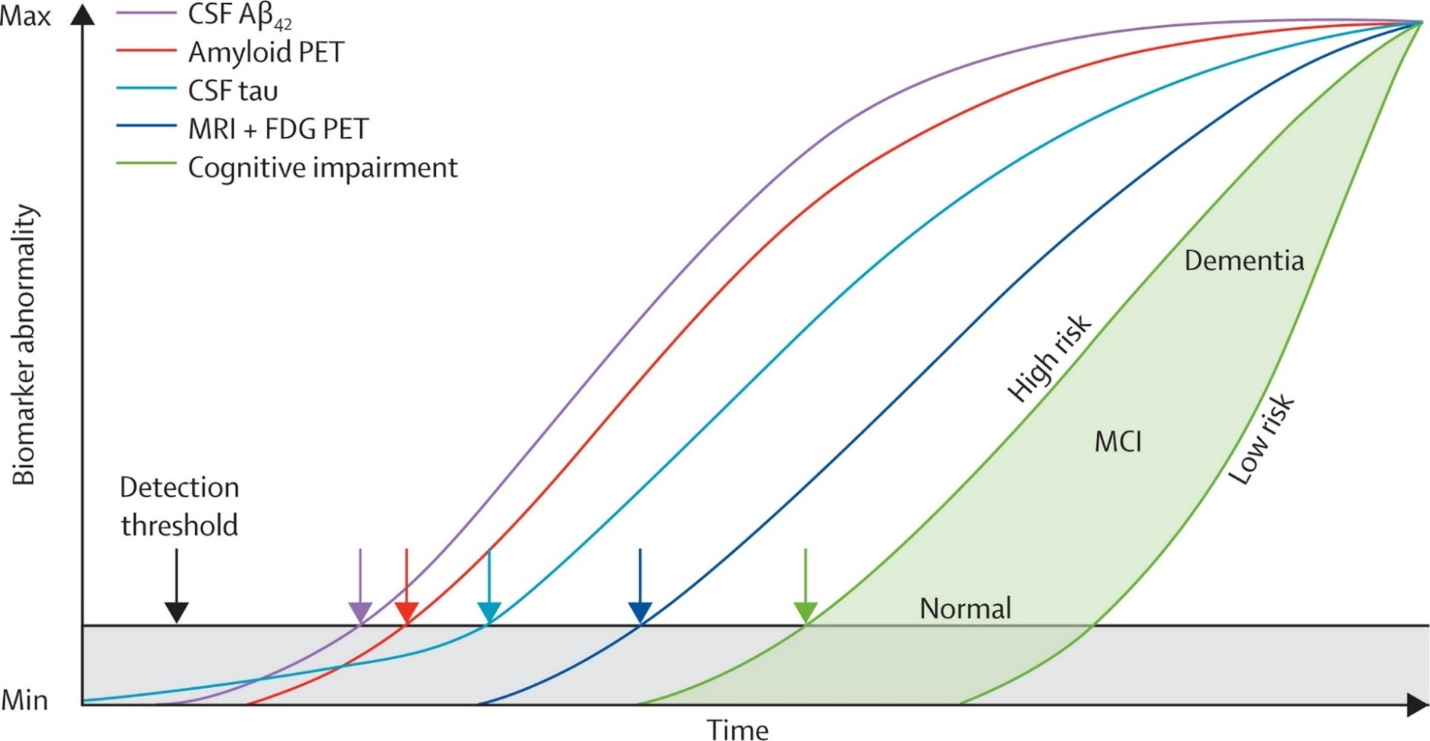
AD pathologic cascade and biomarkers
Hypothetical model of AD biomarkers
Detection
Tracking
Prediction
From: Clark, et al., (2013). Lancet Neurol. 12(2): 207–216.

Slide 7
ADNI resting state fMRI sub-study Overview
886 scan pairs (MRI + rsfMRI) from 220 subjects (as of August, 2016)
Phillips 3T scanners at 14 sites
Downloaded from LONI (USC)
Applied multi-stage image and quality processing procedures
Combination AFNI (NIMH), FSL and home-grown (shell programming; R)
98 scan pairs met all entrance criteria
Maximize commonality in image acquisition
Eliminate subject head-motion as confounding variable
Achieve matched samples across clinical groups (CN, MCI, D)

Slide 8
ADNI resting state fMRI sub-study Overview
Demographics “cleaned” ADNI 2 task-free resting state fMRI dataset

Slide 9
ADNI resting state fMRI sub-study Overview
Preprocessing “cleaned” ADNI 2 task-free resting state fMRI dataset

Slide 10
Seed-based Region of Interest (ROI) Method
DM
DMN PCC ROI Seed (6mm radius)
DMN PCC ROI SEED
Avg GLM Residual Time Series
Reference signal: ROI seed spatial average GLM residual time series
Correlation map: per voxel time series Pearson correlation with reference signal (Fisher z-transform for group-level analysis)

Slide 11

Default mode network (dmn)
>2.58
CN
MCI
Dementia
CN
MCI
Dementia
<-2.58
ROI: posterior cingulate cortex (PCC)
Correlation: medial PFC, l. and r. lat. parietal, med. thalamus, posterior cerebellum
Anti-correlation: l. and r. cuneus, l. and r. inf. temporal, frontopolar PFC

Slide 12
Default mode network (dmn)
DMN CN
DMN MCI
DMN Dementia
L.iTmp
L.ltPar
L.pCB
L.mPF
mThal
PCC
R.iTmp
R.ltPar
R. pCB
Symmetric correlation matrices for 9 DMN nodes for CN, MCI, Dementia

Slide 13
CONTROL network (CON)
>2.58
CN
MCI
Dementia
CN
MCI
Dementia
<-2.58
ROI: dorsal medial pre-frontal cortex (PFC)
Correlation: left and right anterior PFC
Anti-correlation: left and right superior parietal (ISP)

Slide 14
CONTROL network (CON)
CON CN
CON MCI
CON Dementia
Symmetric correlation matrices for 5 CON nodes for CN, MCI, Dementia

Slide 15
Dorsal attention network (DAN)
>2.58
CN
MCI
Dementia
CN
MCI
Dementia
<-2.58
ROI: left Visual Area MT (V5)
Correlation: left and right posterior intraparietal sulcus (IPS)
Anti-correlation: left and right anterior IPS; left and right frontal-eye fields (FEF)

Slide 16
DORSAL ATTENTION network (dAn)
DAN CN
DAN MCI
DAN Dementia
Symmetric correlation matrices for 8 DAN nodes for CN, MCI, Dementia

Slide 17
Salience network (sal)
>2.58
CN
MCI
Dementia
CN
MCI
Dementia
<-2.58
ROI: right anterior cingulate cortex
Correlation: left and right posterior intraparietal sulcus (IPS)
Anti-correlation: left and right anterior IPS; left and right frontal-eye fields (FEF)

Slide 18
SALIENCE network (SAL)
SAL CN
SAL MCI
SAL Dementia
Symmetric correlation matrices for 7 SAL nodes for CN, MCI, Dementia

Slide 19
Salience network (sal)
P_{CDT}=0.05
P_{CDT}=0.05
P_{CDT}=0.05
P_{CDT}=0.10
>2.58
<-2.58
CN
MCI
Dementia
Dementia
ROI: right anterior cingulate cortex
Correlation: left and right posterior intraparietal sulcus (IPS)
Anti-correlation: left and right anterior IPS; left and right frontal-eye fields (FEF)

Slide 20
Sensory-motor network (smn)
CN
MCI
Dementia
>2.58
CN
MCI
Dementia
<-2.58
ROI: supplementary motor area (SMA)
Correlation: left and right motor cortex, left and right primary auditory cortex, left and right primary visual cortex

Slide 21
SENSORY-MOTOR NETWORK (SMN)
SMN CN
SMN MCI
SMN Dementia
Symmetric correlation matrices for 7 SMN nodes for CN, MCI, Dementia

Slide 22
Default mode network (dmn)
CN
MCI
Dementia
>2.58
Text here
<-2.58

Slide 23
Default mode network (dmn)
CN Group ROI Pair Corr. Matrix
MCI Group ROI Pair Corr. Matrix
MCI Group ROI Pair Corr. Matrix
Text here

Slide 24
ADNI resting state fMRI sub-study Overview
886 scan pairs (MRI + rsfMRI) from 220 subjects (as of August, 2016)
Phillips 3T scanners at 14 sites
Multi-stage image and quality processing procedure
Combination AFNI, FSL and home-grown (shell programming; R)
98 scan pairs met all entrance criteria
Maximize commonality in image acquisition
Eliminate subject head-motion as confounding variable
Achieve matched samples across clinical groups (CN, MCI, D)

Slide 25
Alzheimer’s Disease Neuroimaging Initiative (ADNI) - Overview

Slide 26
AD Overview - Definitions
Dementia
Decline in cognitive function that impairs ability to perform activities of daily living (independence)
Mild Cognitive Impairment (MCI)
Measurable decline in cognitive function, but not problematic with respect to activities of daily living
Normal aging
Subtle slowing or decline in memory skills, cognitive speed
Fine line between normal aging and MCI
Notes:
Core principle: Alzheimer’s Disease should be understood within the broader context of dementia and normal aging.

Slide 27
Treatment
No known cure for the underlying causes of Aβ and τ protein
Drug therapies target symptoms – clear Aβ, e.g., aducanumab*
Drug therapies target functional loss, e.g., cholinesterase inhibitors (donepezil, galantamine, rivastigmine), e.g., glutamate antagonist (memantine) blocks NMDA receptors
Chemistry - cognition link is indirect; promising therapies have failed in Phase III clinical trials, e.g., (solanezumab)
*Sevigny, et al., (2016). Nature. 537:50-56.

Slide 28
Research program mission
Generate and apply targeted research findings in systems neuroscience* to improve Alzheimer’s Disease prevention, diagnosis and therapy – translational neuroscience.
*Systems neuroscience includes biostatistics, clinical, cognitive, computational, genetic, neuroimaging and neurophysiological disciplines.

